Slide 1
V. Physical Behavior of Matter

Slide 2
Matter is classified as a pure substance or as a mixture of substances. Matter has mass and takes up space.

Slide 3
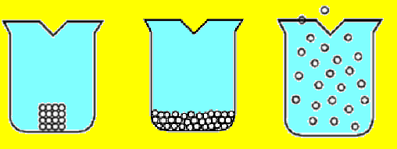
The structure and arrangement of particles and their interactions determine the physical state of a substance at a given temperature and pressure.
Solid | Liquid | Gas

Slide 4
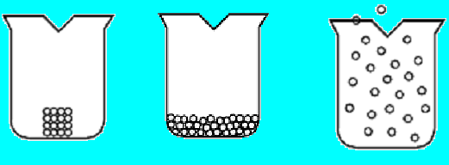
The three phases of matter (solids, liquids, and gases) have different properties.
Solid | Liquid | Gas

Slide 5
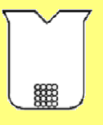
Properties of Solids (s)
Regular geometric pattern in the arrangement of the molecules called a crystal lattice
Molecules are close together and vibrate in place
Molecules do not move from place to place
Solids are not compressible
Definite shape and definite volume

Slide 6
Properties of Liquids (l)
Molecules can move around (fluid) and are farther apart than in a solid
Liquids take the shape of their container
Not compressible
No definite shape but do have definite volume
The forces of attraction between the molecules are weaker in a liquid than they are in a solid.

Slide 7
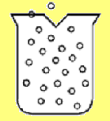
Properties of Gases (g)
Molecules fill their container (spread out)
Molecules are very far apart
Molecules move in straight lines until they hit something (another molecule or wall of the container)
No definite shape and no definite volume
The forces of attraction between the molecules are very weak.

Slide 8
Regents Question: 08/02 #16
Which statement correctly describes a sample of gas confined in a sealed container?
(1) It always has a definite volume, and it takes the shape of the container.
(2) It takes the shape and the volume of any container in which it is confined.
(3) It has a crystalline structure.
(4) It consists of particles arranged in a regular geometric pattern.
þ

Slide 9
Regents Question: 06/02 #12
Which 5.0-milliliter sample of NH₃ will take the shape of and completely fill a closed 100.0-milliliter container?
(1) NH₃ (s) (3) NH₃ (g)
(2) NH₃ (l) (4)NH₃ (aq)
þ

Slide 10
Regents Question: 06/03 #16
In which material are the particles arranged in a regular geometric pattern?
(1) CO₂ (g)
(2) NaCl(aq)
(3) H₂O(l)
(4) C₁₂H₂₂O₁₁ (s)
þ

Slide 11
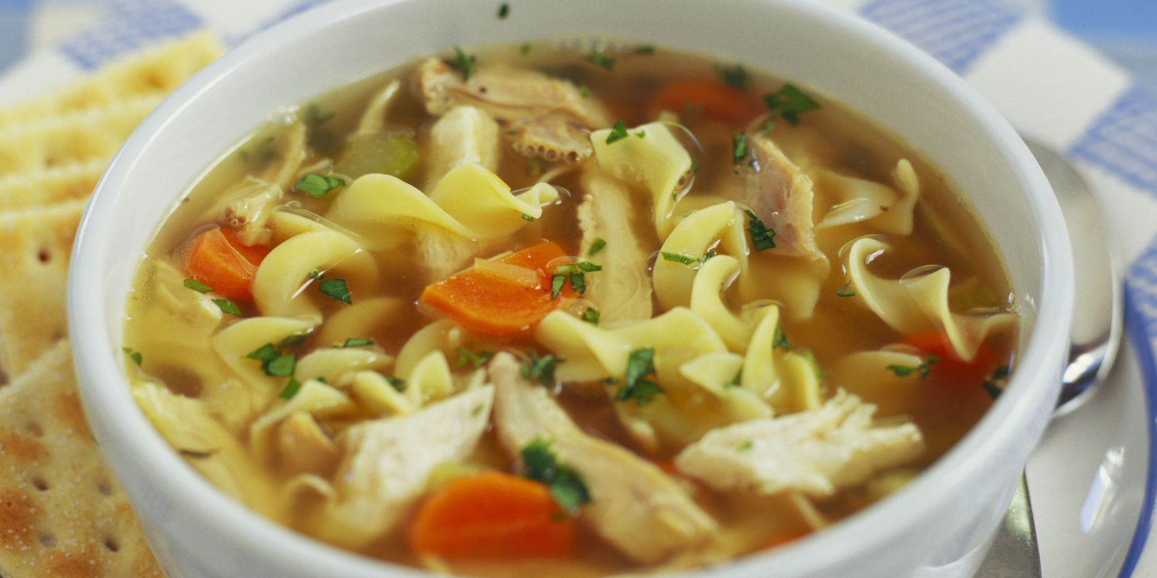
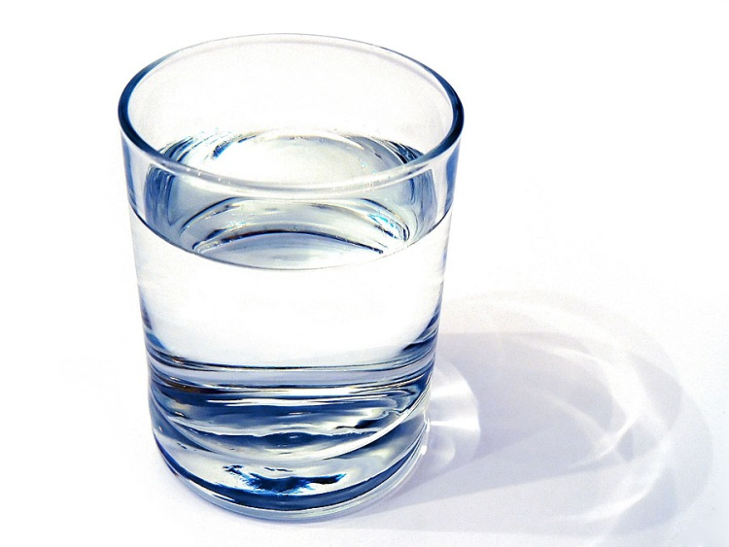
Coffee and soup are both matter but …

Slide 12
A pure substance has a constant composition and constant properties throughout a given sample, and from sample to sample.
All substances are homogeneous.

Slide 13
Mixtures are composed of two or more different substances that can be separated by physical means.

Slide 14
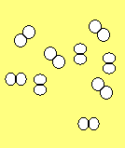
Matter can look like the following diagrams
Substances |  |  | Mixtures
Elements | Diatomic Elements | Compounds

Slide 15
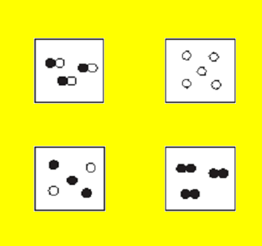
Using particle diagrams to represent elements, compounds and mixtures.
Compound
Element
Mixture
Diatomic element

Slide 16
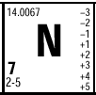
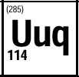
Elements *substances that are composed of atoms that have the same atomic number. *cannot be broken down by chemical change. *Elements are represented by chemical symbols with the first letter of the symbol is always a capital letter the rest are lower case
Nitrogen
Neon
A temporary symbol

Slide 17
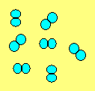
Some elements are diatomic. They come in pairs when not combined with other elements.
Br I N Cl H O F
Diatomic Elements
Bromine
Iodine
Nitrogen
Chlorine
Hydrogen
Oxygen\
Fluorine
Neon is a monatomic element
Nitrogen is a diatomic element

Slide 18
Compounds are substances that are composed of two or more different elements chemically combined.
The elements in a compound are in fixed proportions and are represented by chemical formulas
A compound can only be decomposed by chemical means
Compounds are electrically neutral

Slide 19
Regents Question: 08/02 #6
Which species represents a chemical compound?
(1) N₂ (3) Na
(2) NH₄⁺ (4) NaHCO₃
þ
Compounds are made up of more than one type of element. (Look for more than one capital letter.)
Compounds are electrically neutral.

Slide 20
When different substances are mixed together, a homogeneous or heterogeneous mixture is formed.

Slide 21
A homogeneous mixture is evenly mixed. It is called a solution. Ex. NaCl(aq). (aq) stands for aqueous = dissolved in water. An alloy is a solution of metals ex. brass, bronze

Slide 22
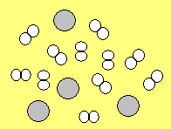
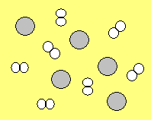
Heterogeneous mixture proportions of components in a mixture can be varied. Each component in a mixture retains its original properties.
Two mixtures of Hydrogen (H₂) and Neon (Ne)

Slide 23
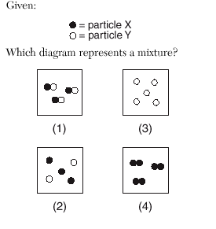
Regents Question: 06/02 #43
þ

Slide 24
Regents Question: 08/02 #51
On a field trip, Student X and Student Y collected two rock samples. Analysis revealed that both rocks contained lead and sulfur. One rock contained a certain percentage of lead and sulfur by mass, and the other rock contained a different percentage of lead and sulfur by mass. Student X stated that the rocks contained two different mixtures of lead and sulfur. Student Y stated that the rocks contained two different compounds of lead and sulfur. Their teacher stated that both students could be correct.
Draw particle diagrams in each of the rock diagrams provided in your answer booklet to show how Student X’s and Student Y’s explanations could both be correct. Use the symbols in the key provided in your answer booklet to sketch lead and sulfur atoms.

Slide 25
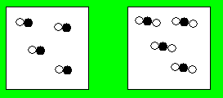
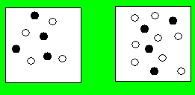
Regents Question: 08/02 #51 Answer
Draw particle diagrams in each of the rock diagrams provided in your answer booklet to show how Student X’s and Student Y’s explanations could both be correct. Use the symbols in the key provided in your answer booklet to sketch lead and sulfur atoms.
Student X
Student Y
Rock A Rock B

Slide 26
Regents Question: 06/03 #15
Which of these terms refers to matter that could be heterogeneous?
(1) element
(2) mixture
(3) compound
(4) solution
þ

Slide 27
A physical change results in the rearrangement of existing particles in a substance. A chemical change results in the formation of different substances with changed properties.
Physical Changes
Changes in phase
Melting
Boiling
Subliming
Dissolving
Chemical Changes
Any chemical reaction
Synthesis
Decomposion
Single Replacment
Double Replacement
Combustion (burning)

Slide 28
Regents Question: 06/03 #18
Which type of change must occur to form a compound?
(1) chemical
(2) physical
(3) Nuclear
(4) phase
þ

Slide 29
Intermolecular forces created by the unequal distribution of charge result in varying degrees of attraction between molecules. Hydrogen bonding is an example of a strong intermolecular force. (5.2m)
Dipole-Dipole attraction between polar molecules

Slide 30
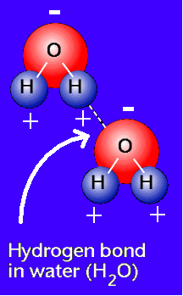
Hydrogen bonds occur when hydrogen is bonded to a small, highly electronegative atom.
N, O and F can have hydrogen bonds when hydrogen is bonded to it.
Account for the unusual properties of water:
High boiling point, surface tension, six sided snowflake

Slide 31
Physical properties of substances can be explained in terms of chemical bonds and intermolecular forces.
Ionic bonds are strong
Hydrogen bonds are strong intermolecular forces
Polar molecules exhibit attraction between the + and – sides of their molecules
Bonds between nonpolar molecules are weak. The more protons in the molecule, the stronger these forces.

Slide 32
Differences in properties such as density, particle size, molecular polarity, boiling point and freezing point, and solubility permit physical separation of the components of the mixture.
Density and polarity
Particle Size
solubility
Chromatography, Filtration, Dissolving, Distillation, Crystallization
Boiling Point
Freezing Point

Slide 33
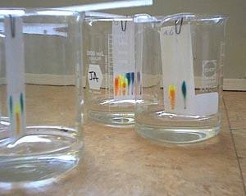
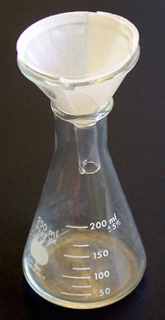
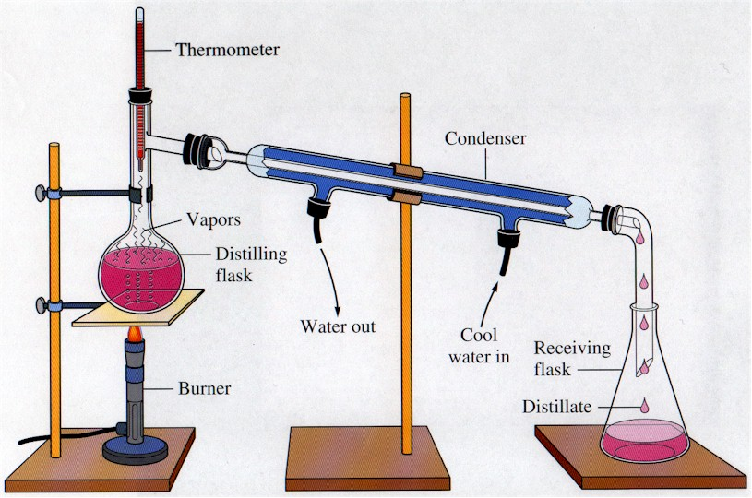
Density and polarity
Particle size
Boiling point

Slide 34
Regents Question: 06/03 #9
Which substance can be decomposed by a chemical change?
(1) Co
(2) CO
(3) Cr
(4) Cu
þ

Slide 35
Regents Question: 01/04 #12
A bottle of rubbing alcohol contains both 2-propanol and water. These liquids can be separated by the process of distillation because the 2-propanol and water
(1) have combined chemically and retain their different boiling points
(2) have combined chemically and have the same boiling point
(3) have combined physically and retain the different boiling points
(4) have combined physically and have the same boiling point
þ

Slide 36
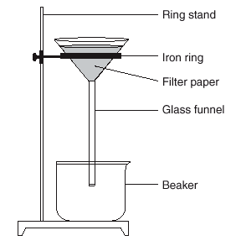
Regents Question: 08/02 #7
Which mixture can be separated by using the equipment shown?
(1) NaCl(aq) and SiO₂(s)
(2) NaCl(aq) and C₆H₁₂O₆(aq)
(3) CO₂(aq) and NaCl(aq)
(4) CO₂(aq) and C₆H₁₂O₆(aq)
þ
(aq) stands for aqueous which means dissolved in water.
Dissolved particles are too small to be trapped by the filter.

