Slide 1
VI. Kinetics/Equilibrium

Slide 2
The rate of a chemical reaction depends on several factors: temperature, concentration, nature of reactants, surface area, and the presence of a catalyst.
Increase temperature – faster rate
More kinetic energy
Molecules move faster
Collide more often and with more energy
Increase concentration – faster rate
More particles to collide with
Increase surface area- smaller particles- faster rate
More sites for collisions to occur

Slide 3
*The nature of the reactants
Solids react slowly
Gases react quickly
Ions in solution react VERY quickly
Catalyst
- lowers the activation energy to speed up a chemical reaction without being used up
- Provides an alternate pathway for a reaction

Slide 4
Raising the temperature increases the reaction rate by
Increasing both the number of collisions and the efficiency of the collisions.

Slide 5
As the pressure on gas-phase reactants ↑, the rate of rxn …
Increases.

Slide 6
Catalyst
Substance that increases the rate of a chemical reaction without itself being consumed.

Slide 7
As the concentrations of the reactants ↑, the rate of rxn …
increases

Slide 8
Regents Question: 01/03 #5
Which event must always occur for a chemical reaction to take place?
(1) formation of a precipitate
(2) formation of a gas
(3) effective collisions between reacting particles
(4) addition of a catalyst to the reaction system
þ

Slide 9
6 Factors that influence the rate of reaction
Nature of reactants (ionic or covalent)
Temperature
Concentration
Pressure (for gases)
Surface area (for heterogeneous reactions)
Presence of a catalyst

Slide 10
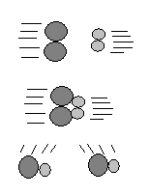
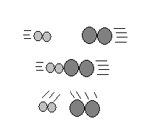
Collision theory states that a reaction is most likely to occur if reactant particles collide with the proper energy and orientation.
An ineffective collision reaction does not occur
An effective collision reaction occurs

Slide 11
Energy released or absorbed during a chemical reaction (heat of reaction-ΔH ) is equal to the difference between the potential energy of the products and the potential energy of the reactants.
ΔH = PE products – PE reactants

Slide 12
Enthalpy (ΔH) The heat of reaction
ΔH=PE products – PE reactants
The value for ΔH is the same in the forward and the reverse reaction. Only the sign is changed.
Measured in kJ (kilojoules)
+ ΔH – Endothermic – Energy absorbed
- ΔH – Exothermic – Energy released
The large the value of ΔH, the more energy absorbed or released
Reference Table I gives ΔH for many reactions

Slide 13
Exothermic Reaction
Energy is released: It flows from system to environment. Temperature of environment increases.

Slide 14
Endothermic Reaction
Energy is absorbed: It flows from environment to system. Temperature of environment drops.

Slide 15
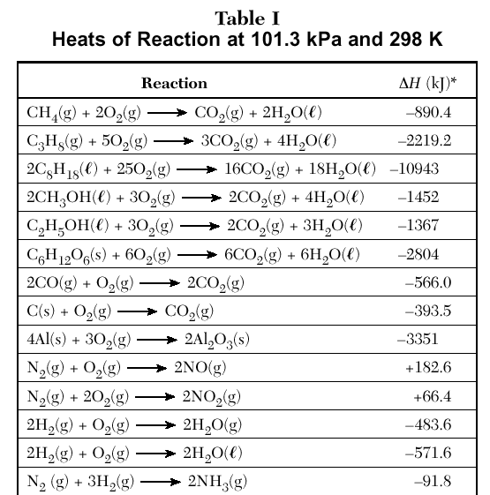
Table I gives heats for many different types of reactions.

Slide 16
Regents Question: 08/02 #14
Given the reaction:
CH₄ (g) + 2 O₂ (g) → 2 H₂O(g) + CO₂ (g)
What is the overall result when CH₄ (g) burns according to this reaction?
(1) Energy is absorbed and ΔH is negative.
(2) Energy is absorbed and Δ H is positive.
(3) Energy is released and Δ H is negative.
(4) Energy is released and Δ H is positive.
þ

Slide 17
Regents Question: 08/02 #34
According to Table I, which salt releases energy as it dissolves?
(1) KNO₃ (3) NH₄NO₃
(2) LiBr (4) NaCl
þ

Slide 18
Regents Question: 08/02 #34
According to Table I, which salt releases energy as it dissolves?
(1) KNO₃ (3) NH₄NO₃
(2) LiBr (4) NaCl
þ

Slide 19
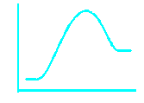
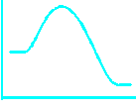
Exothermic
Potential energy decreases
Releases energy
ΔH is negative
Energy is on the right
2H₂ + O₂ 2H₂O + energy
Endothermic
Potential energy increases
Absorbs energy
ΔH is positive
Energy is on the left
2H₂O + energy 2H₂ + O₂
PE
PE

Slide 20
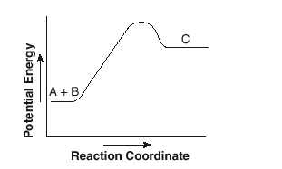
Regents Question: 06/02 #55-56
Given the reaction:
A + B → C
Does the diagram illustrate an exothermic or an endothermic reaction?
Endothermic
State one reason, in terms of energy, to support your answer.
On the diagram provided in your answer booklet, draw a dashed line to indicate a potential energy curve for the reaction if a catalyst is added.
Energy is absorbed. Potential energy is increasing.

Slide 21
A catalyst speeds up both the forward and reverse reactions equally.
Using a catalyst will not effect the equilibrium.

Slide 22
Regents Question: 06/03 #35
A catalyst is added to a system at equilibrium. If the temperature remains constant, the activation energy of the forward reaction
(1) decreases
(2) increases
(3) remains the same
þ

Slide 23
ΔH is positive?
Endothermic reaction. Products have more potential energy than reactants.

Slide 24
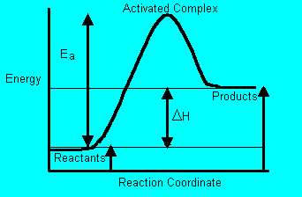
Energy released or absorbed by a chemical reaction can be represented by a potential energy diagram.

Slide 25
ΔH for endothermic rxn
ΔH is positive. System has net gain in energy.

Slide 26
ΔH is negative?
Exothermic reaction. Products have less potential energy than reactants.

Slide 27
ΔH for exothermic rxn
ΔH is negative. System has net loss in energy.

Slide 28
The difference between the potential energy of the products & the potential energy of the reactants?
H_{products} – H_{reactants} or ΔH

Slide 29
Heat of reaction, ΔH
H_{products} - H_{reactants}

Slide 30
Endothermic Reaction
Energy is absorbed: It flows from environment to system. Temperature of environment drops.

Slide 31
Exothermic Reaction
Energy is released: It flows from system to environment. Temperature of environment increases.

Slide 32
A + B → C + D. ΔH = -45 kJ.
What is ΔH for C + D → A + B?
ΔH = +45 kJ

Slide 33
A reaction occurs in water & the temperature of the water decreases. Endo or Exo?
Endothermic

Slide 34
A reaction occurs in water & the temperature of the water increases. Endo or Exo?
Exothermic

Slide 35
Which phase change is endothermic?
Gas to liquid
Gas to solid
Solid to gas
Liquid to solid

Slide 36
A + B + heat → C + D
Endothermic Reaction. Heat term is on reactant side.

Slide 37
A + B → C + D + heat
Exothermic Reaction. Heat term is on product side.

Slide 38
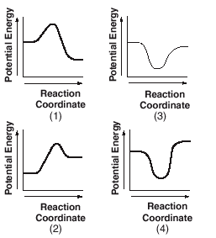
Regents Question: 08/02 #41
According to Table I, which potential energy diagram best represents the reaction that forms H₂O(l) from its elements?

Slide 39
Regents Question: 06/03 #21
Which statement correctly describes an endothermic chemical reaction?
(1) The products have higher potential energy than the reactants, and the ΔH is negative.
(2) The products have higher potential energy than the reactants, and the Δ H is positive.
(3) The products have lower potential energy than the reactants, and the Δ H is negative.
(4) The products have lower potential energy than the reactants, and the Δ H is positive.
þ

Slide 40
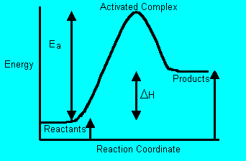
Activation Energy (E_{a}) is the energy needed to get a reaction started (reach the activated complex).

Slide 41
Endo: starts low, ends high
Endo or Exo?

Slide 42
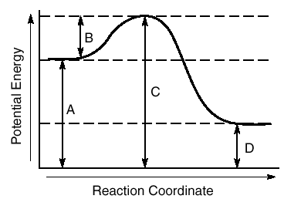
Regents Question: 06/03 #43
The potential energy diagram below represents a reaction.
Which arrow represents the activation energy of the forward reaction?
(1) A (2) B (3) C (4) D
þ

Slide 43
Regents Question: 08/02 #50
Given the reaction:
2 H₂ (g) + O₂ (g) → 2 H₂O(l) + 571.6 kJ
What is the approximate ΔH for the formation of 1 mole of H₂O(l)?
(1) –285.8 kJ (3) –571.6 kJ
(2) +285.8 kJ (4) +571.6 kJ
þ

Slide 44
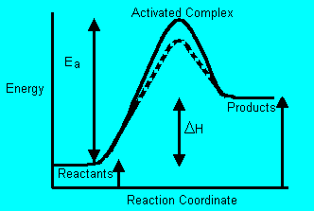
A catalyst provides an alternate reaction pathway, which has a lower activation energy than an uncatalyzed reaction. (3.4g)
Activated Complex With Catalyst

Slide 45
Activation energy of forward rxn
Identify the arrow

Slide 46
Potential energy of reactants
Identify the arrow

Slide 47
Activated Complex
Reactants
Products
Identify reactants, products, activated complex

Slide 48
Exo: starts high, ends low
Endo or Exo?

Slide 49
Exo: starts high, ends low
Endo or Exo?

Slide 50
Potential energy of reactants
Identify the arrow

Slide 51
Heat of reaction
Identify the arrow

Slide 52
Activation energy of forward rxn
Identify the arrow

Slide 53
Potential energy of activated complex
Identify the arrow

Slide 54
Potential energy of products
Identify the arrow

Slide 55
Potential energy of products
Identify the arrow

Slide 56
Activation energy of reverse reaction
Identify the arrow

Slide 57
Heat of reaction
Identify the arrow

Slide 58
Lowers the activation energy.
Effect of a catalyst?

Slide 59
Potential energy of activated complex
Identify the arrow

Slide 60
Activation energy of reverse rxn
Identify the arrow

Slide 61
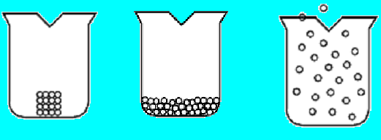
Entropy is a measure of the randomness or disorder of a system. A system with greater disorder has greater entropy.
Solids have low entropy, gases have high entropy

Slide 62
Entropy increases when
A phase change makes it more disorganized
More moles of gas are produced
Higher temperature = more motion= more dissorder

Slide 63
Reactions that depend on temperature – when entropy and enthalpy don’t agree.
Exothermic ☺ and Decrease Entropy ☹
H₂O(l) H₂O(s) + energy
Endothermic ☹ and Increase Entropy ☺
H₂O(s) + energy H₂O(l)
Changing phase depends on temperature because entropy and enthalpy can’t agree if the reaction should proceed or not.

Slide 64
Systems in nature tend to undergo changes toward lower energy and higher entropy.
A reaction which is exothermic and increases entropy will always occur spontaneously. ☺
A reaction that is endothermic and decreases entropy will never occur spontaneously. ☹

Slide 65
Nature is lazy & disorganized.
Nature favors:
Negative value for ΔH: Net loss
Positive value for ΔS: Net gain

Slide 66
Which phase has the greatest entropy?
Gas phase – the molecules have more ways of moving & more places to be!

Slide 67
Which phase has the greatest entropy?
S_{gas} >> S_{liquid} > S_{solid}

Slide 68
Did the entropy increase or decrease?
NaCl(s) → Na⁺(aq) + Cl⁻(aq)
Increase!

Slide 69
Did the entropy increase or decrease?
2H₂O(l) → 2H₂(g) + O₂(g)
Increase!

Slide 70
When will a change never occur?
When both factors go against nature:
Positive value for ΔH: Net gain in energy.
Negative value for ΔS: Net loss in chaos

Slide 71
Catalyst
Does not shift the equilbrium point – the equilibrium concentrations are the same. You just get to equilibrium quicker.

Slide 72
Regents Question: 06/02 #44
Which process is accompanied by a decrease in entropy?
(1) boiling of water
(2) condensing of water vapor
(3) subliming of iodine
(4) melting of ice
þ

Slide 73
Regents Question: 08/02 #39
Which sample has the lowest entropy?
(1) 1 mole of KNO₃ (l) (3)1 mole of H₂O(l)
(2) 1 mole of KNO₃ (s) (4) 1 mole of H₂O(g)
þ

Slide 74
Regents Question: 06/03 #50
As carbon dioxide sublimes, its entropy
(1) decreases
(2) increases
(3) remains the same
þ
Sublimation is a phase change from solid directly into gas.

Slide 75
At equilibrium the rate of the forward reaction equals the rate of the reverse reaction. The amount of reactants and products remain constant at equilibrium.
3H₂(g) + N₂(g) 2NH₃(g)
We read the double arrow “is in equilibrium with.” We can also use an equal sign (=) or other double arrows (  )

Slide 76
Some chemical and physical changes can reach equilibrium. (3.4h)
Types of equilibrium
Phase
Between solid and liquid at its melting point
Between a liquid and a gas in a sealed container
Solution
Between dissolved and undissolved solute in a saturated solution
Chemical
Reversible chemical reactions can reach equilibrium

Slide 77
Dynamic Equilibrium
Rate of forward process
=
Rate of reverse process
Notes:
Play tape, demo of tubes and water. Demo of baseball team

Slide 78
Regents Question: 06/02 #57
Given the reaction at equilibrium:
N₂ (g)+ 3 H₂ (g) =2 NH₃ (g) + 92.05 kJ
a State the effect on the number of moles of N₂ (g) if the temperature of the system is increased.
b State the effect on the number of moles of H₂ (g) if the pressure on the system is increased.
c State the effect on the number of moles of NH₃ (g) if a catalyst is introduced into the reaction system. Explain why this occurs.
The number of moles of N₂ would increase
The number of moles of H₂ would decrease
No effect. A catalyst speeds up both the forward and reverse reactions the same amount

Slide 79
Regents Question: 01/03 #11
Which type or types of change, if any, can reach equilibrium?
(1) a chemical change, only
(2) a physical change, only
(3) both a chemical and a physical change
(4) neither a chemical nor a physical change
þ

Slide 80
At equilibrium the concentrations do not change.
Hydrogen and nitrogen are changing into ammonia as fast as ammonia is changing into hydrogen and nitrogen.
The amounts of each (concentrations) are not necessarily equal, only the rates of reaction are equal.
At equilibrium, the concentrations do not change.
3H₂(g) + N₂(g) 2NH₃(g)

Slide 81
Regents Question: 06/02 #35
Given the equilibrium reaction at STP:
N₂O₄ (g) = 2 NO₂ (g)
Which statement correctly describes this system?
(1) The forward and reverse reaction rates are equal.
(2) The forward and reverse reaction rates are both increasing.
(3) The concentrations of N₂O₄ and NO₂ are equal.
(4) The concentrations of N₂O₄ and NO₂ are both increasing.
þ

Slide 82
Regents Question: 08/02 #13
Which statement correctly describes a chemical reaction at equilibrium?
(1) The concentrations of the products and reactants are equal.
(2) The concentrations of the products and reactants are constant.
(3) The rate of the forward reaction is less than the rate of the reverse reaction.
(4) The rate of the forward reaction is greater than the rate of the reverse reaction.
þ

Slide 83
Regents Question: 08/02 #60
The equation for the saturated solution equilibrium of potassium nitrate (KNO₃ ) is shown below.
KNO₃ (s) + energy K⁺ (aq) + NO₃– (aq)
Compare the rate of dissolving KNO₃ with the rate of recrystallization of KNO₃ for the saturated solution.
The rate of dissolving equals the rate of recrystallization

Slide 84
LeChatelier’s principle can be used to predict the effect of stress (change in pressure, volume, concentration, and temperature) on a system at equilibrium.
When you add something, the reaction tries to use it up
When you remove something, the reaction tries to replace it
Changes in pressure only affect gases
Changes in temperature has greater affect on the endothermic side
A catalyst does not cause a shift in equilibrium

Slide 85
Equilibrium on a see-saw 3H₂(g) + N₂(g) 2NH₃(g)+ energy
Upsetting the equilibrium is like upsetting a balanced see-saw with the reactants on the left side, products on the right
Pressure favors the side with less moles of gas (pretend that pressure is just another reactant or product) 4 moles of gas on the left, 2 on the right
Temperature affects the endothermic side (pretend that energy is just another reactant or product) exothermic on the right, endothermic on the left)

Slide 86
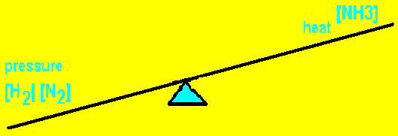
Equilibrium on a see-saw 3H₂(g) + N₂(g) 2NH₃(g)+ energy
Use [ ] to indicate concentration. [H₂] is read “The concentration of H_{2.}”
If I increase anything on one side, that side goes down and the other side goes up
Inc [H₂]
[N₂] and pressure go down
[NH₃] and temperature go up

Slide 87
N₂(g) + 3H₂(g) ↔ 2NH₃(g) + heat
Equilibrium shifts to the right.
Concentration of N₂ & H₂ ↓. Temperature ↑.
Stress
What happens?

Slide 88
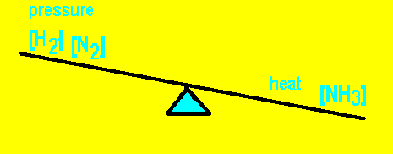
Equilibrium on a see-saw 3H₂(g) + N₂(g) 2NH₃(g)+ energy
If I remove something from one side, the other things on that side go up and the other side goes down.
Dec [H₂]
[NH₃] and temperature go down
[N₂] and pressure go up

Slide 89
N₂(g) + 3H₂(g) ↔ 2NH₃(g) + heat
Equilibrium shifts to the left.
Concentration of N₂ ↑. Concentration of NH₃ ↓. Temperature ↓.
Stress
What happens?

Slide 90
Add to the right, shift to the left. Add to the left, shift to the right. Remove from the right, shift to the right. Remove from the left, shift to the left.
3H₂(g) + N₂(g) 2NH₃(g)+ energy
Causes a shift to the right
Increase [H₂]*
Increase [N₂]
Decrease [NH₃]
Decrease temperature
Increase pressure
Causes a shift to the left
Decrease [H₂]
Decrease [N₂]
Increase [NH₃]
Increase temperature
Decrease pressure
*[H₂] is read “The concentration of H₂”

Slide 91
Regents Question: 08/02 #38
Given the equilibrium reaction in a closed system:
H₂ (g) + I₂ (g) + heat = 2 HI(g)
What will be the result of an increase in temperature?
(1) The equilibrium will shift to the left and [H₂ ] will increase.
(2) The equilibrium will shift to the left and [H₂ ] will decrease.
(3) The equilibrium will shift to the right and [HI] will increase.
(4) The equilibrium will shift to the right and [HI] will decrease.
þ

Slide 92
Regents Question: 01/03 #50
Given the system at equilibrium:
N₂O₄ (g) + 58.1 kJ 2 NO₂ (g)
What will be the result of an increase in temperature at constant pressure?
(1) The equilibrium will shift to the left, and the concentration of NO₂ (g) will decrease.
(2) The equilibrium will shift to the left, and the concentration of NO₂ (g) will increase.
(3) The equilibrium will shift to the right, and the concentration of NO₂ (g) will decrease.
(4) The equilibrium will shift to the right, and the concentration of NO₂ (g) will increase.
þ

Slide 93
Catalyst
Substance that increases the rate of a chemical reaction without itself being consumed.

Slide 94
Heat of reaction, ΔH
H_{products} - H_{reactants}

Slide 95
The difference between the potential energy of the products & the potential energy of the reactants?
H_{products} – H_{reactants} or ΔH

Slide 96
ΔH for exothermic rxn
ΔH is negative. System has net loss in energy.

Slide 97
ΔH is negative?
Exothermic reaction. Products have less potential energy than reactants.

Slide 98
ΔH is positive?
Endothermic reaction. Products have more potential energy than reactants.

Slide 99
ΔH for endothermic rxn
ΔH is positive. System has net gain in energy.

Slide 100
A + B → C + D + heat
Exothermic Reaction. Heat term is on product side.

Slide 101
A + B + heat → C + D
Endothermic Reaction. Heat term is on reactant side.

Slide 102
Which phase change is endothermic?
Gas to liquid
Gas to solid
Solid to gas
Liquid to solid

Slide 103
A reaction occurs in water & the temperature of the water increases. Endo or Exo?
Exothermic

Slide 104
A reaction occurs in water & the temperature of the water decreases. Endo or Exo?
Endothermic

Slide 105
Entropy
Degree of disorder or chaos in a system.

Slide 106
Entropy
The more degrees of freedom a system has, the higher the entropy.

Slide 107
S
Entropy

Slide 108
H
Enthalpy
or
Chemical Potential Energy

Slide 109
Conditions for Equilibrium
2-way process
Closed System

Slide 110
Dynamic Equilibrium
Macroscopic level – looks constant.
Microscopic level – lots of action

Slide 111
Types of Equilibria
Physical:
Phase: closed system
Solution:
gas in liquid
solid in liquid (saturated solutions)
Chemical

Slide 112
A solution at equilibrium must be
Saturated

Slide 113
Phase Equilibrium
H₂O(l) ↔ H₂O(g)

Slide 114
Solution Equilibrium Ionic Cmpd
NaCl(s) ↔ Na⁺(aq) + Cl⁻(aq)

Slide 115
Solution Equilibrium Covalent Cmpd
C₆H₁₂O₆(s) ↔ C₆H₁₂O₆(aq)

Slide 116
H₂O(g) ↔ H₂O(l)
Phase Equilibrium

Slide 117
At what temperature can H₂O(s) and H₂O(l) exist in equilibrium?
0°C or 273K

Slide 118
At what temperature can H₂O(g) and H₂O(l) exist in equilibrium?
100°C or 373K

Slide 119
NH₄Cl(s) ↔ NH₄⁺(aq) + Cl⁻(aq)
Solution Equilibrium

Slide 120
Chemical Equilibrium – Haber Synthesis
N₂(g) + 3H₂(g) ↔ 2NH₃(g) + heat

Slide 121
LeChatelier’s Principle
A system at equilibrium will respond to remove a stress

Slide 122
What’s a stress for a chemical system?
Change in temperature, pressure, or concentration

Slide 123
N₂(g) + 3H₂(g) ↔ 2NH₃(g) + heat
Equilibrium shifts to right.
Concentration of H₂ ↓. Concentration of NH₃ ↑. Temperature ↑
Stress
What happens?

Slide 124
Pressure Changes
Only affect systems that have a gas in them

Slide 125
Catalyst
Does not shift the equilbrium point – the equilibrium concentrations are the same. You just get to equilibrium quicker.

Slide 126
N₂(g) + 3H₂(g) ↔ 2NH₃(g) + heat
Shifts to the side with fewer moles of gas, in this case the right.
4 moles
2 moles
How does this system respond to an increase in pressure?

Slide 127
An increase in pressure favors which side?
CO₂(g) ↔ CO₂(aq)
When P ↑, more CO₂ dissolves!

Slide 128
N₂(g) + 3H₂(g) ↔ 2NH₃(g) + heat
Shifts to the side with more moles of gas, in this case the left.
How does this system respond to a decrease in pressure?

Slide 129
H₂(g) + I₂(g) + heat ↔ 2HI(g)
This system has the same # of moles on each side. It cannot respond to pressure changes.
2 moles
2 moles
How does this system respond to a decrease in pressure?

Slide 130
NaCl(s) → Na⁺(aq) + Cl⁻(aq)
This system has no gases. It does NOT respond to pressure changes.
How does this system respond to a change in pressure?

Slide 131
N₂(g) + 3H₂(g) ↔ 2NH₃(g) + heat
Equilibrium shifts to the left.
Concentration of N₂ & H₂ ↑. Temperature ↓.
Stress
What happens?

